Slide 1
ELECTRICAL B

Slide 2
PREPADED BY:-
1) BALDANIA MUKESH
2) BHANBHANIA URMESH
3) BARAIYA YOGESH
4) BHALANI HARDIK
5) BHATT VISHAL
6) BHUT KEYUR
7) CHAUHAN PRATAP
8) CHAUHAN VIRAL
9) CHAVDA RAVINA
10) DABHI KALPESH

Slide 3
ELEMENTS OF ELECTRICAL
ENGINEERING
CHAPTER :- 6
THREE PHASE AC CIRCUIT

Slide 4
POLYPHASE CIRCUITS
TWO WATT METER METHOD
PHASE AND LINE VOLTAGES IN DELTA CONNECTED LOAD
LINE &PHASE VOLTAGE FOR DELTA CONNECTED LOAD

Slide 5
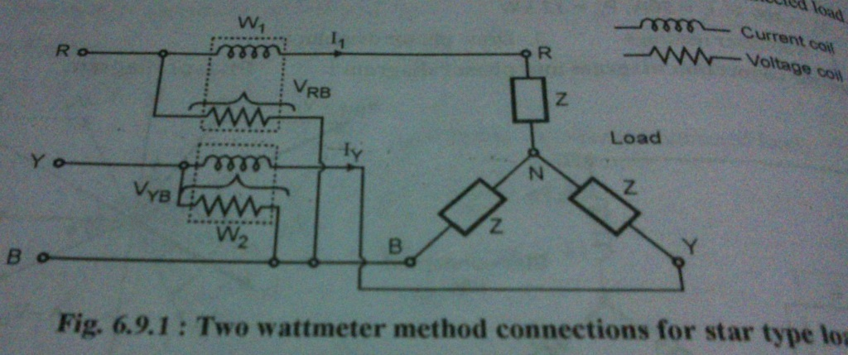
TWO WATT METER METHOD

Slide 6
PRINCIPLE BEHIND THE CONNECTION
CAREFULLY OBSERVE THE WAY IN WHICH THE CURRENT AND THE VOLTAGE COILS OF THE CONNECTED.
THE WAMETER CONNECTION WILL REMAIN THE SAME IRRESPECTIVE OF THE TYPE OF LOAD.
THE TOTAL POWER IN A THREE PHASE CIRCUIT IS EQUAL TO THE ALGEBRIC SUM OF THE TWO WATTMETER READINGS.
TOTAL POWER W=W1+W2
WHERE W1 AND W2 ARE THE WATTMETR READINGS.

Slide 7
LINE &PHASE VOLTAGE FOR DELTA CONNECTED LOAD
LINE VOLTAGE:
THE LINE VOLTAGE IS DEFIND AS THE POTENTIAL DIFFERENCE BETWEEN ANY TWO LINES.SO Vry,Vrb,Vyb,Vbr,Vyr,Vby ARE SIXPOSSIBLE LINE VOLTAGES.
ALL THE LINE VOLTAGE ARE SINEWAVES OF 50Hz FREQUENCY &THE PHASE SHIFT BETWEEN THE ADJACENT LINE VOLTAGES IS 60DEGREE.

Slide 8
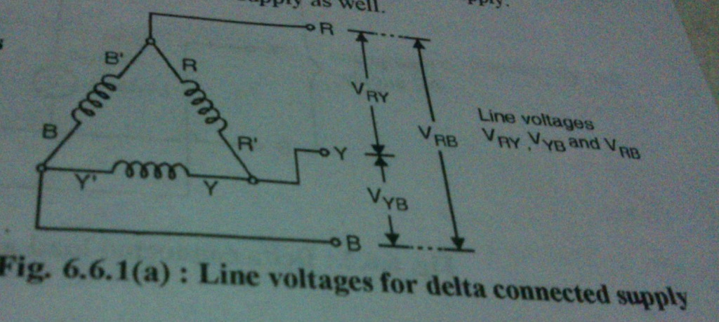
LINE VOLTAGE

Slide 9
PHASE VOLTAGES
THE VOLTAGE MEASURED ACROSS A SINGLE WINDING IS CALLED AS THE PHASE VOLTAGE.
NOTE THAT THE PHASE VOLTAGES ARE Vry,Vyb,Vrb...ETC.WHICH ARE NOTHING BUT LINE VOLTAGE.
THUS FOR A DELTA CONNECTED SUPPLY THE PHASE VOLTAGES ARE SAME AS LINE VOLTAGES.
TYPICAL VALUES OF LINE &PHASE VOLTAGES FOR A DELTA CONNECED SUPPLY ARE 415V OR 440V.

Slide 10
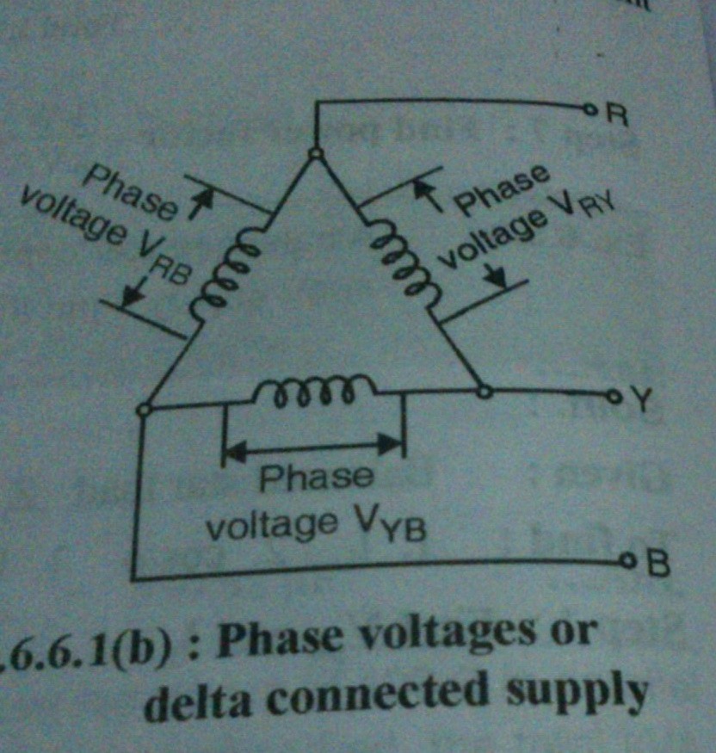
PHASE VOLTAGE

Slide 11
PHASE AND LINE VOLTAGES IN DELTA CONNECTED LOAD
WE HAVE ALREADY DEFINED THE LINE VOLTAGE &PHASE VOLTAGES.
NOTE THAT BOTH THESE VOLTAGES ARE IDENTICAL.
HENCE FOR THE DELTA CONNECTION,LINE VOLTAGE =PHASE VOLTAGE
Vph=VL=Vvry, Vrb, Vyb

Slide 12
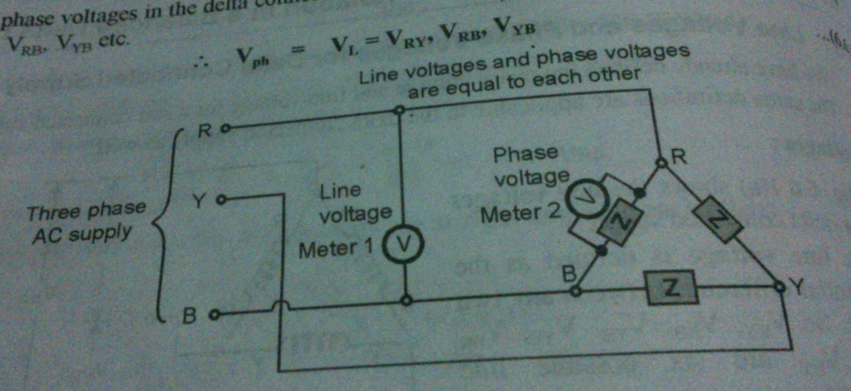
PHASE AND LINE VOLTAGES IN DELTA CONNECTED LOAD

Slide 13
Thank You
MADE BY:- KEYUR BHUT

Slide 14
THE
END

